Slide 1
Informatica feminale 2019
CODE CAMP

Slide 2
IoT and MQTT
What the hell is Iot?

Slide 3
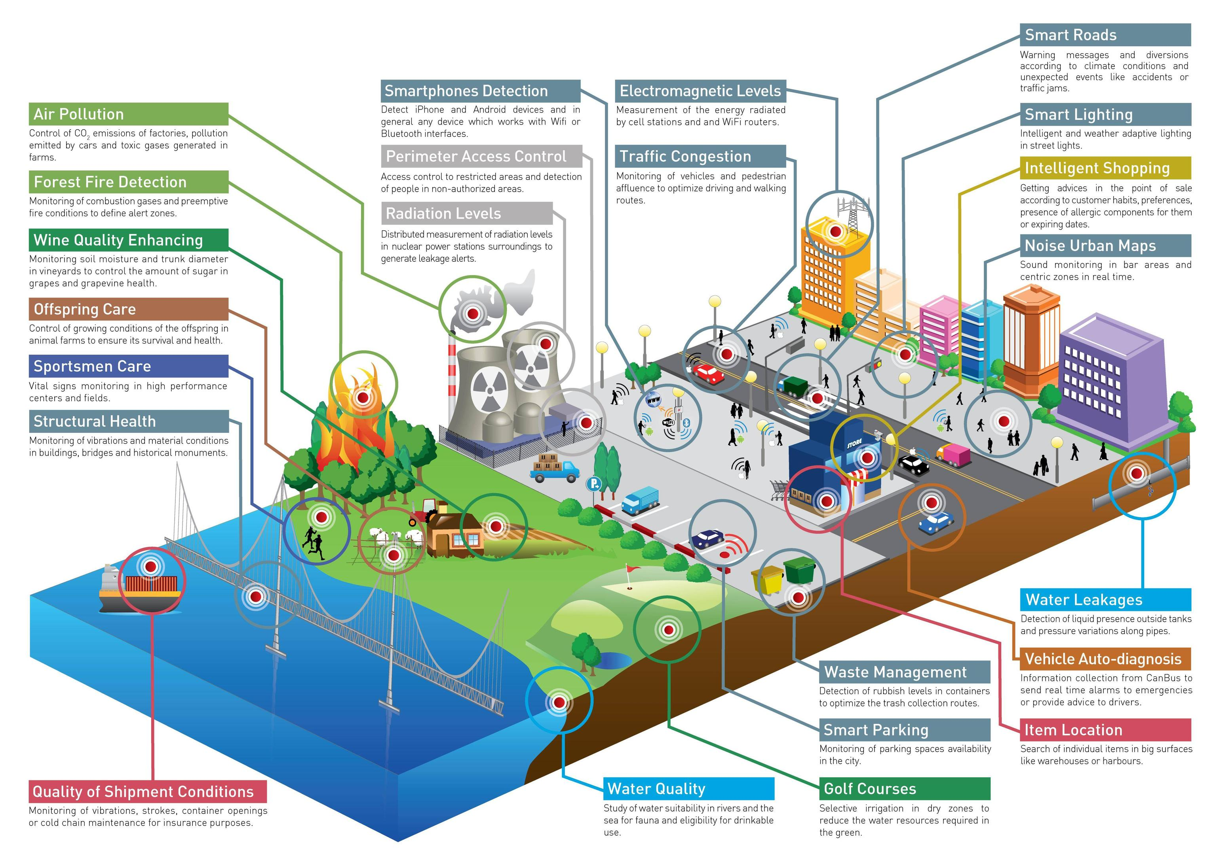

Slide 4
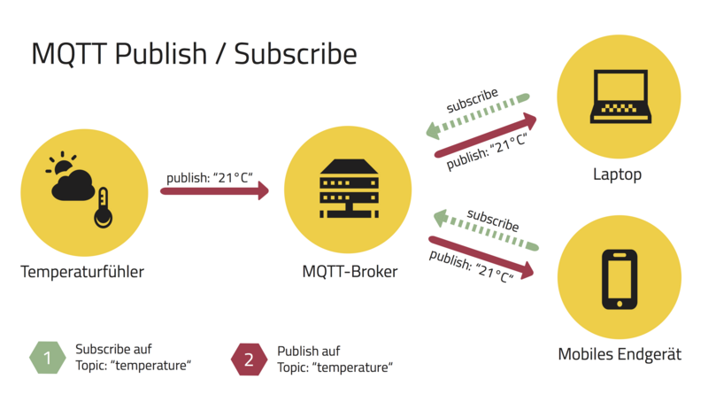
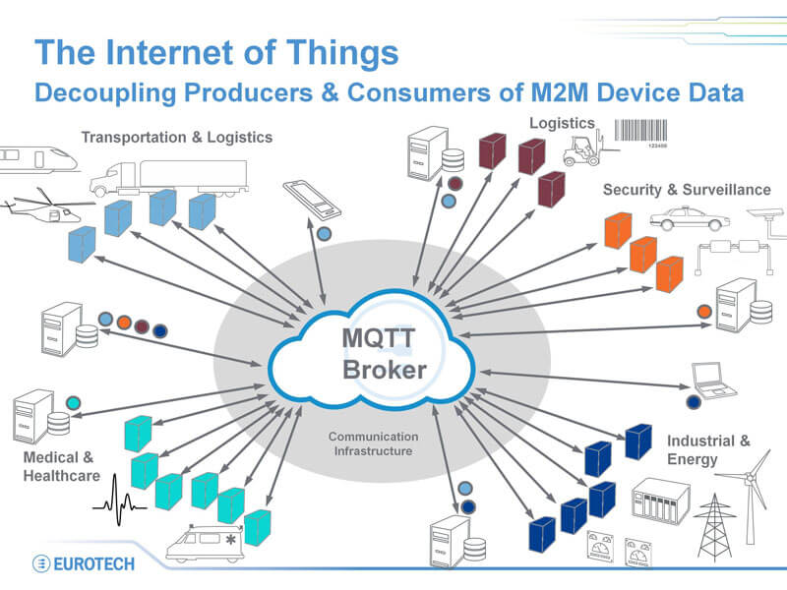
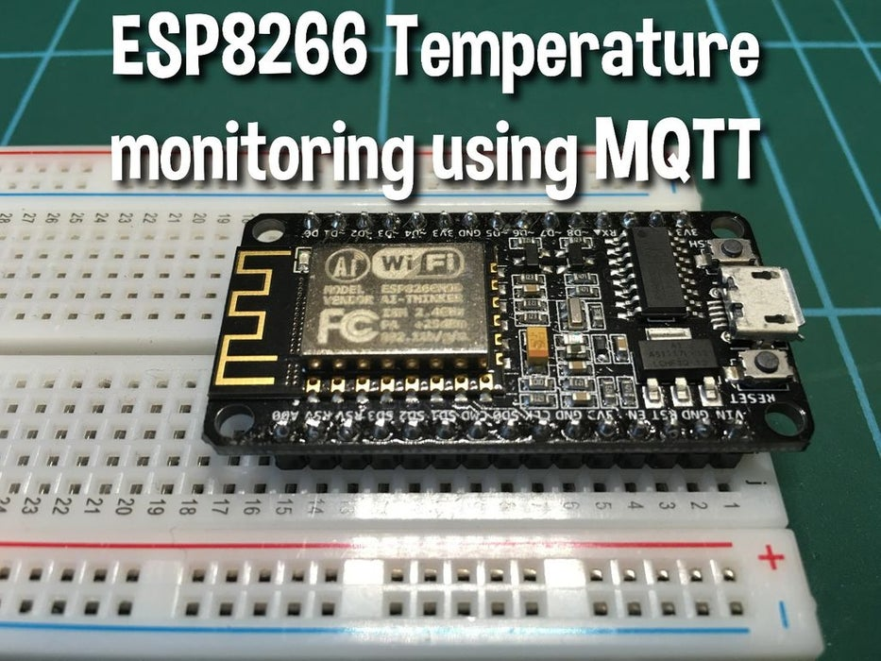
https://www.instructables.com/id/Remote-Temperature-Monitoring-Using-MQTT-and-ESP82/

Slide 5
Design patterns
What is a modern Software design?
Are there any reusable ideas from the ancestors?

Slide 6
Design patterns – what is it?
Design patterns are solutions to software design problems you find again and again in real-world application development.
Patterns are about reusable designs and interactions of objects.
The 23 Gang of Four (GoF) patterns are generally considered the foundation for all other patterns.
They are categorized in three groups: Creational, Structural, and Behavioral

Slide 7
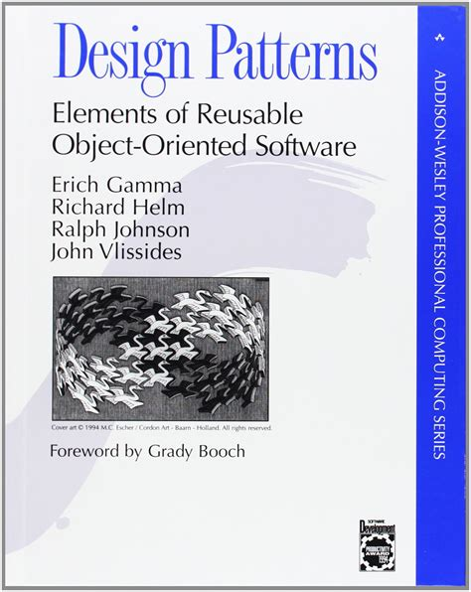
Gang of Four (Gof)
Erich Gamma
Richard Helm
Ralph Johnson
John Vlissides
Design patterns for object-oriented languages
1994

Slide 8
Creational patterns – create objects
Abstract Factory Creates an instance of several families of classes
Builder Separates object construction from its representation
Factory Method Creates an instance of several derived classes
Prototype A fully initialized instance to be copied or cloned
Singleton A class of which only a single instance can exist

Slide 9
Structural patterns – control your structure
Adapter Match interfaces of different classes
Bridge Separates an object’s interface from its implementation
Composite A tree structure of simple and composite objects
Decorator Add responsibilities to objects dynamically
Façade A single class that represents an entire subsystem
Flyweight A fine-grained instance used for efficient sharing
Proxy An object representing another object

Slide 10
Behavioral patterns – Dynamics in code flow
Chain of Resp. A way of passing a request between a chain of objects
Command Encapsulate a command request as an object
Interpreter A way to include language elements in a program
Iterator Sequentially access the elements of a collection
Mediator Defines simplified communication between classes
Memento Capture and restore an object's internal state
Observer A way of notifying change to a number of classes
State Alter an object's behavior when its state changes
Strategy Encapsulates an algorithm inside a class
Template Method Defer the exact steps of an algorithm to a subclass
Visitor Defines a new operation to a class without change

Slide 11
Model view controller (MVC)
Already pretty old….. First implemented in the 1970s
Classis pattern for client-server communication and separation of concerns
In IoT (= Internet of Things) the pattern is widely adopted
MQTT is one of the easiest IoT protocols

Slide 12

Model view controller (MVC)
Separate the model from the view and from the control logic
action
Controller
update
interact
View (UI)
update
Model
notify
User

Slide 13
Model view controller (MVC)
Advantages
Simultaneous development – Multiple developers can work simultaneously on the model, controller and views.
High cohesion MVC enables logical grouping of related actions on a controller or on a model together.
Loose coupling - the very nature of the MVC framework is such that there is low coupling among models, views or controllers
Ease of modification – Because of the separation of responsibilities, future development or modification is easier
Multiple views for a model – Models can have multiple views

Slide 14
Model view controller (MVC)
Disadvantages
Code navigability – The framework navigation can be complex because it introduces new layers of abstraction and requires users to adapt to the decomposition criteria of MVC.
Multi-artifact consistency – Decomposing a feature into three artifacts causes scattering. Thus, requiring developers to maintain the consistency of multiple representations at once.
Undermined by inevitable clustering – Applications tend to have heavy interaction between what the user sees and what the user uses. Therefore each feature's computation and state tends to get clustered into one of the 3 program parts, erasing the purported advantages of MVC.
Pronounced learning curve – Knowledge on multiple technologies becomes the norm. Developers using MVC need to be skilled in multiple technologies.
Lack of incremental benefit – UI applications are already factored into components, and achieving code reuse and independence via the component architecture, leaving no incremental benefit to MV

Slide 15
Maze solver - Model view controller (MVC)
using MQTT as communication protocol
action as MQTT message
Maze Solver
interact
View (UI)
Model
update as MQTT message
User
Maze Generator
action as MQTT message

Slide 16
Maze solver - Model view controller (MVC)
What is your job now?
action as MQTT message
MQTT
Client
Maze Solver
interact
View (UI)
Model
update as MQTT message
User
Maze Generator
action as MQTT message

Slide 17
Maze solver - Model view controller (MVC)
What is your job now?
action as MQTT message
MQTT
Client
A*
BreadthFirst
…
interact
View (UI)
Model
update as MQTT message
User
Maze Generator
action as MQTT message

Slide 18
Maze solver - Resources
https://github.com/AntoniaSophia/MazeRunner
Templates
for MQTT client MazeSolverMQTTClientTemplate.py
for MAZE solver MazeSolverAlgoTemplate.py
action as MQTT message
MQTT
Client
update as MQTT message
A*
BreadthFirst
…

Slide 19
1
= receive and interprete MQTT message
2
= send information to Maze Solver
This is your job now – recommended order
3
= code your solver separately (use loadMaze)
4
= send back information as MQTT message
2
action as MQTT message
1
MQTT
Client
Maze Solver
3
4
interact
View (UI)
Model
update as MQTT message
User
Maze Generator
action as MQTT message

Slide 20
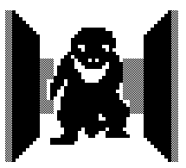
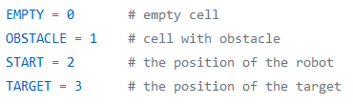
0
0
0
0
2
0,4
0
1
1
1
1
0
1
0
1
3
2,4
0
1
0
0
0
0
0
0
1
0

Slide 21
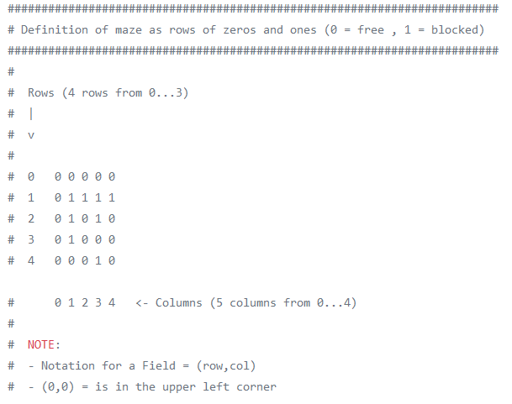
MAZE grid - see also test_maze_generator.py
0,0
0,1
0,2
0,3
0,4
0,4
Start
1,0
1,1
1,2
1,3
1,4
2,0
2,1
2,2
2,3
0,4
2,4
Target
3,0
3,1
3,2
3,3
3,4
4,0
4,1
4,2
4,3
4,4

Slide 22
MAZE grid Representation
NOTE:
Notation for a field is (row , column)
Numbering starts from 0
The upper left corner is position (0,0)
0
0
0
0
2
0,0
0,1
0,2
0,3
0,4
0,4
0,4
Start
1,0
1,1
1,2
1,3
1,4
0
1
1
1
1
0
1
0
1
3
2,0
2,1
2,2
2,3
0,4
2,4
2,4
Target
3,0
3,1
3,2
3,3
3,4
0
1
0
0
0
4,0
4,1
4,2
4,3
4,4
0
0
0
1
0

Slide 23
MQTT Protocol
/topic payload
Examples
/maze clear Topic: /maze Payload: clear
/maze/dimRow 5 Topic: /maze/dimRow Payload: 5

Slide 24
MQTT Protocol – available topics
/maze
clear → clear grid and be ready to receive a new maze
start → now the new maze transmission starts via MQTT
end → maze transmission via MQTT has ended
solve → start solving the maze
/maze/dimRow → dimension of the maze in rows
/maze/dimCol → dimension of the maze in columns
/maze/startRow → row of the starting point in the maze
/maze/startCol → column of the starting point in the maze
/maze/endRow → row of the end point in the maze
/maze/endCol → column of the end point in the maze
/maze/blocked → this grid element is blocked in row,col
/maze/go → go to next grid element in row,col
1
= receive and interprete MQTT message
4
= send back information as MQTT message

Slide 25
MAZE Solver example
/maze/go 0,3
/maze/go 0,2
/maze/go 0,1
0,0
0,1
0,2
0,3
0,4
0
0,4
0
0
0
0
2
/maze/go 0,0
0,4
Start
1,0
1,1
1,2
1,3
1,4
/maze/go 1,0
0
1
1
1
1
2,0
2,1
2,2
2,3
2,4
2,4
0
1
0
1
3
/maze/go 2,0
2,4
/maze/go 2,4
Target
3,0
3,1
3,2
3,3
3,4
0
1
0
0
0
/maze/go 3,4
/maze/go 3,0
/maze/go 3,3
/maze/go 3,2
4,0
4,1
4,2
4,3
4,4
/maze/go 4,0
0
0
0
1
0
/maze/go 4,1
/maze/go 4,2

Slide 26
Maze solver
Great explanation of BreadthFirst, Dijkstra, A*
https://www.redblobgames.com/pathfinding/a-star/introduction.html
Implementation details:
https://www.redblobgames.com/pathfinding/a-star/implementation.html

Slide 27
Clean Code
Aka Code….
which works
which is easy to understand
easy to modify
easy to test

Slide 28
What is Clean Code?
“Any fool can write code that a computer can understand. Good programmers write code that humans can understand.”
-- Martin C. Fowler
A philosophy evolved behind this term: the idea of SW development as a craftsmanship which has to be learned over years and continuously be exercised and improved
Clean Code = a reader-focused development style that produces software that is easy to
read
maintain
understand
change
used by other programmers

Slide 29
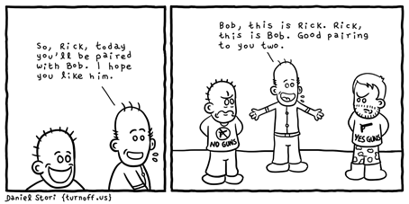
Clean Code – HOW? (1/3)
Felipe Ribeiro from Spotify and Job van der Voort from GitLab on Landing Jobs 2017:
Document everything and make decisions (ex: release) based on facts
Asynchronous communication like peer review or code review
Good practices like methods names intuitive and not too long
Give time to refactoring your code
Automated tests included in Continuous Integration system
Use design patterns which makes code readable
Define code coverage per team depending on maturity (create unit tests is part of DoD)

Slide 30
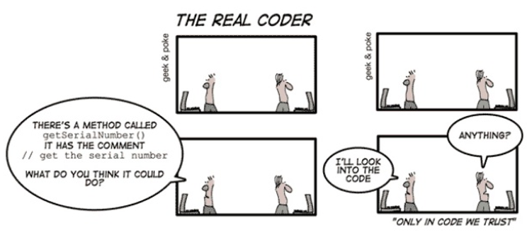
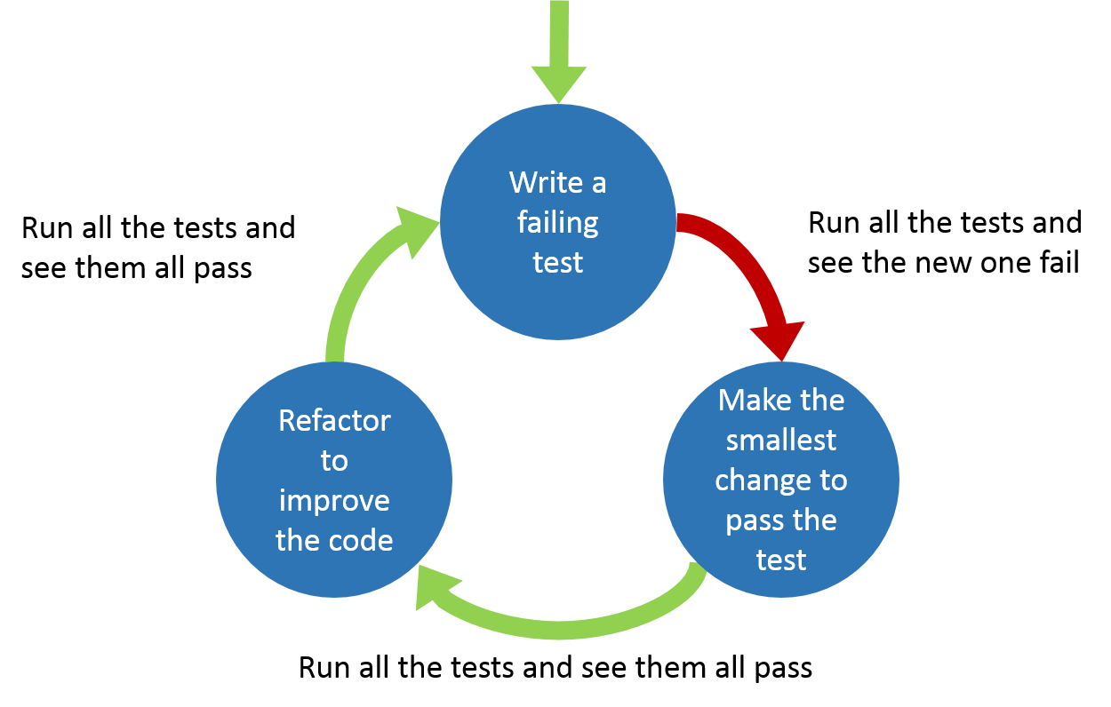
Clean Code – HOW? (2/3)
Coding Guidelines:
Naming Conventions
Refactoring
More Frequent Commits, Fewer Problems
Adding or Removing Files
Compiling the Code
Making Sure Not to Break Other People’s Stuff
Updating Comments to Reflect Reality
Removing Temporary Code
Running the Unit Tests
Running Static Analysis
Automate as Much as You Can
TDD / BDD / ATDD

Slide 31
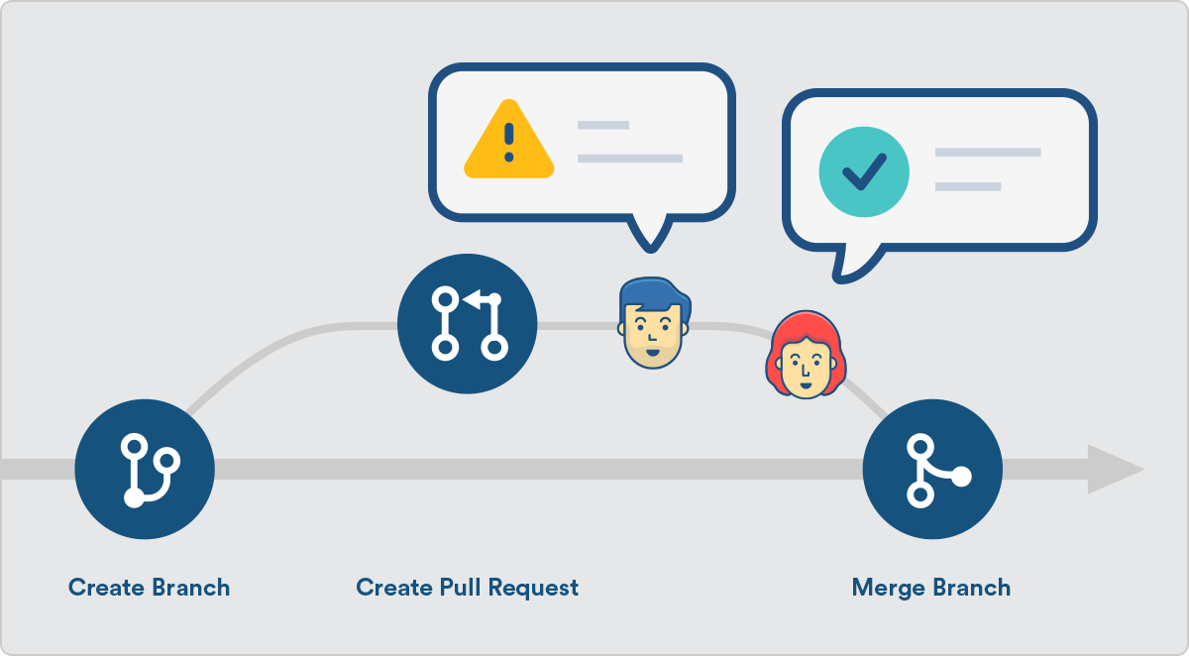
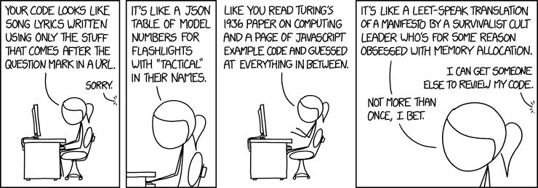
Clean Code – HOW? (3/3)
Help of Tools - e.g. Git, Static Code Analysis
Code Review
Pull Request main feature from Bitbucket
Coding Standard rules
SonarQube (central Static Analysis Tool)
Sonar Lint (local IDE – code checker)
BugFinder
Checkmarx
....

Slide 32
Some more information on Clean Code
Clean Code Community https://clean-code-developer.com/
Uncle Bob https://sites.google.com/site/unclebobconsultingllc/
Clean Code CheatSheet https://www.bbv.ch/images/bbv/pdf/downloads/V2_Clean_Code_V3.pdf
Great slidesets http://www.jeremybytes.com/Downloads/Slides-CleanCode.pdf https://www.slideshare.net/arturoherrero/clean-code-8036914
Talk on Clean Code http://georg-gruetter.de/clean-code-oscon-2018.mp4
El Rizitas Code Review

Slide 33
Unit Test

Slide 34
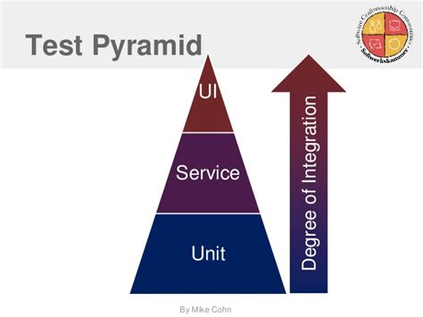
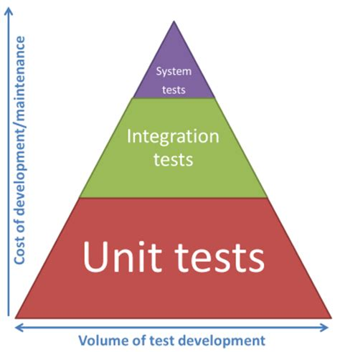
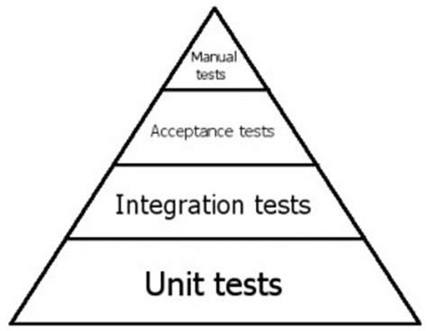
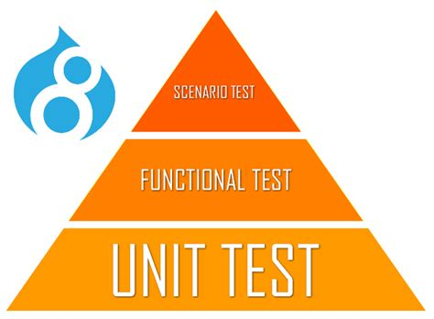
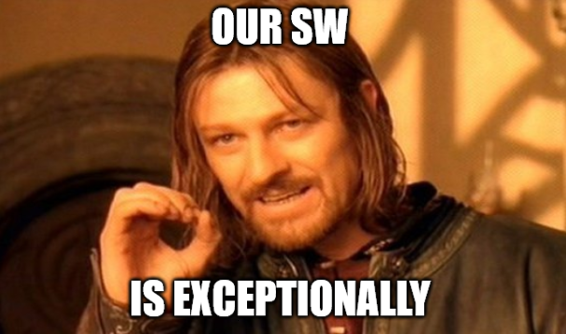
Unit test
According to all literature ressources a highly recommended test pyramid for SW development looks like this
Deviating from this recommendation can only be justified by two reason
We are more clever than all others in the area of SW development
Our SW is totally different from other SW

Slide 35
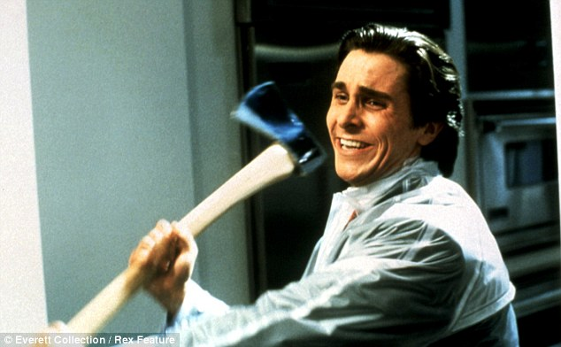
Why Unit test?
Confidence in the code, trust in the overall system
Code decays over time: technical debt
Side effects: changes in one place needs changes in another place
Mechanism for efficient debugging
“Write your code as if the person that's going to maintain it is a psychotic serial killer who knows where you live.”

Slide 36
Properties of a good unit test
It should be automated and repeatable
It should be easy to implement
It should be relevant tomorrow
Anyone should be able to run it at the push of a button
It should run quickly
It should be consistent in its results (always returns the same result test is unchanged between runs)
It should have full control of the unit under test
It should be fully isolated (runs independently of other tests)
When it fails, it should be easy to detect what was expected and determine how to pinpoint the problem

Slide 37
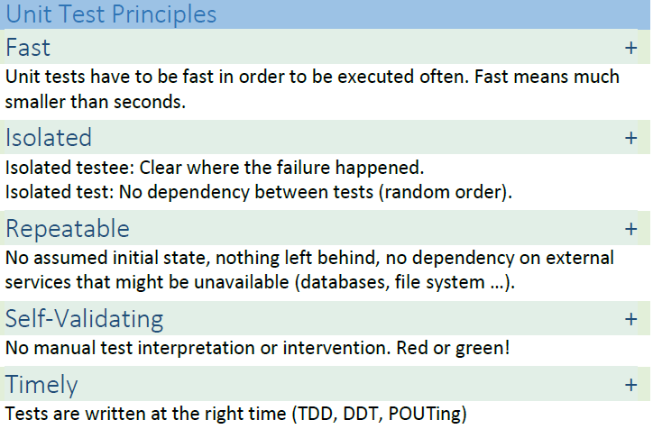
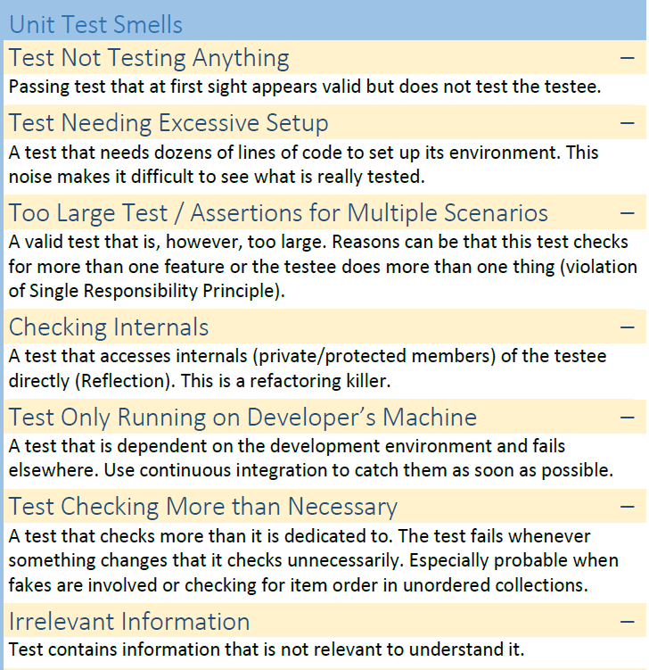
Unit Tests – what does clean code tell us?
DO
Don‘t Do
Source: Clean Code Cheatsheet

Slide 38
Unit Tests – who?
Unit Testing is an essential task for the SW developer
SW developers know best how the unit under test should work
Peer reviews among different SW developers can serve as 4-eye principle
Mostly the test script implementation will be in the same programming language as the code itself
Some of the test frameworks can be integrated in the developer IDE. So it is very close to use
Good Unit Tests are extremely helpful for gaining trust after refactoring
Awareness of the impact of renaming / refactoring / beautifying activities on code and architecture level.
Awareness on importance how important well detail designs and clear understandable comments in the code are will be grow

Slide 39
Unit Tests – Coverage
C0 → Statement coverage / Instruction coverage (cover every line of code)
C1 → Branch coverage (cover every branch)
C2 → Decision coverage (cover every decision)
It hold C2 contains C1 contains C0
https://en.wikipedia.org/wiki/Code_coverage
Further coverage metrics in Avionik and Automotive or safety critical systems
MC/DC → Modified condition / decision coverage

Slide 40
Unit Tests – Coverage
Graph
If (a==true or b==true)
Example:
Line 1: If (a == true or b == true) Line 2: print(“hello world”)
TestCaseSet : a = true, b = true → Line 1 evaluates to true , Line 2 is executed (1 Testcase) → C0 = 100% (2 of 2 lines are being executed) → C1 = 50% (1 of 2 branches are executed – invisible branch!) → C2 = 25% (1 of 4 decision are being executed)
It hold C2 contains C1 contains C0
a == true or
b == true
a == false and
b == false
print(“hello world”)
do nothing
(invisible branch !)

Slide 41
Unit Tests – Coverage
Graph
If (a==true or b==true)
Example:
Line 1: If (a == true or b == true) Line 2: print(“hello world”)
TestCaseSet : a = true, b = true → Line 1 evaluates to true , Line 2 is executed (2 Testcases) a = false, b = false → Line 1 evaluates to false, Line 2 is not executed → C0 = 100% (2 of 2 lines are being executed) → C1 = 100% (2 of 2 branches are executed – invisible branch!) → C2 = 50% (2 of 4 decision are being executed)
a == true or
b == true
a == false and
b == false
print(“hello world”)
do nothing
(invisible branch !)

Slide 42
Unit Tests – Coverage
Graph
If (a==true or b==true)
Example:
Line 1: If (a == true or b == true) Line 2: print(“hello world”)
TestCaseSet : a = true, b = true → Line 1 evaluates to true , Line 2 is executed (4 Testcases) a = false, b = false → Line 1 evaluates to false, Line 2 is not executed a = true, b = false → Line 1 evaluates to true , Line 2 is executed a = false, b = true → Line 1 evaluates to true , Line 2 is executed → C0 = 100% (2 of 2 lines are being executed) → C1 = 100% (2 of 2 branches are executed – invisible branch!) → C2 = 100% (4 of 4 decision are being executed)
a == true or
b == true
a == false and
b == false
print(“hello world”)
do nothing
(invisible branch !)

Slide 43
Unit Tests – Coverage
Example:
Line 1: If (a == true or b == true) Line 2: print(“hello world”)
TestCase 2: a == false, b == false → Line 1 evaluates to false , Line 2 is not executed → C0 = 50% (1 of 2 lines is being executed) → C1 = 50% (1 of 2 branches are executed) → C2 = 25% (1 of 4 decision are being executed)

Slide 44
Technical debt and Sonarqube
What is quality?
Can we measure quality?

Slide 45
Devops

Slide 46
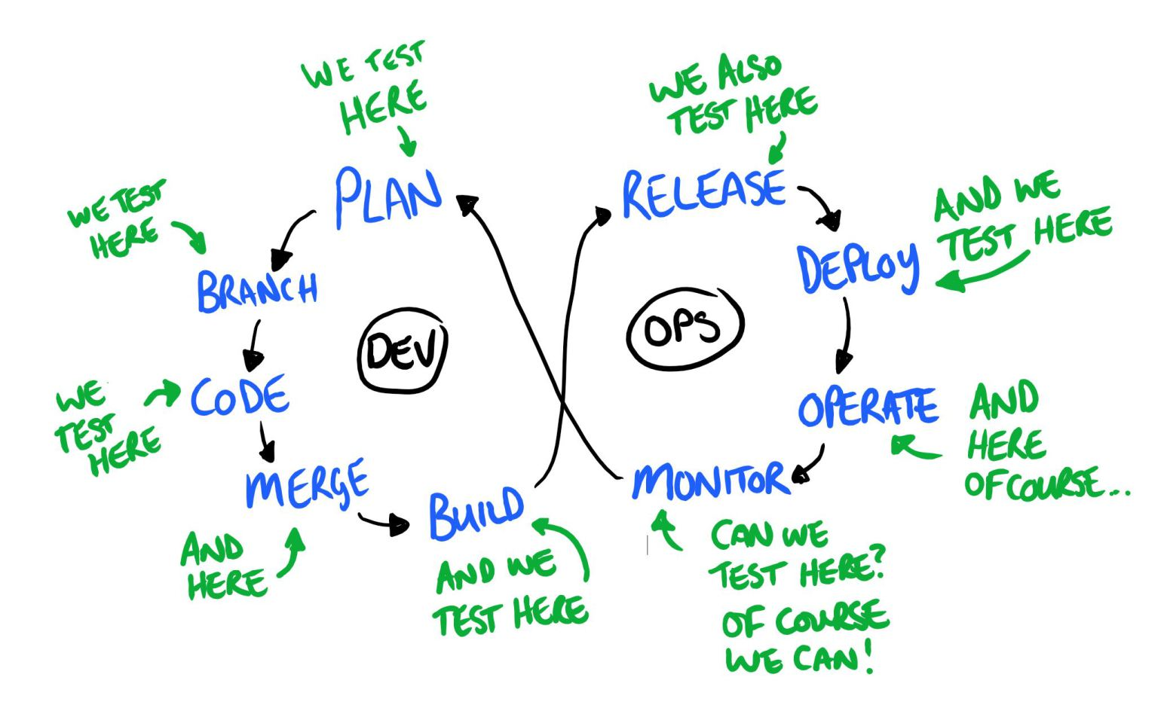
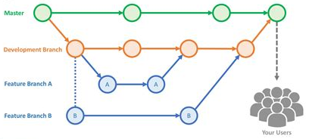
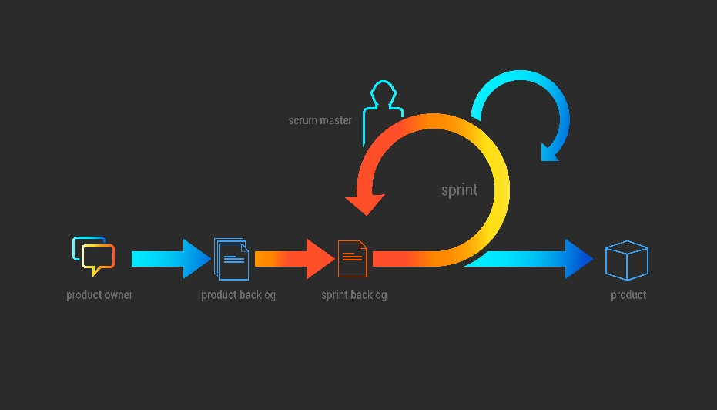
A much better DevOps Cycle
“The most powerful tool we have as developers is automation.”
“DevOps is a re-org, not a new team to hire.”
“Develop systems, not software.”

Slide 47
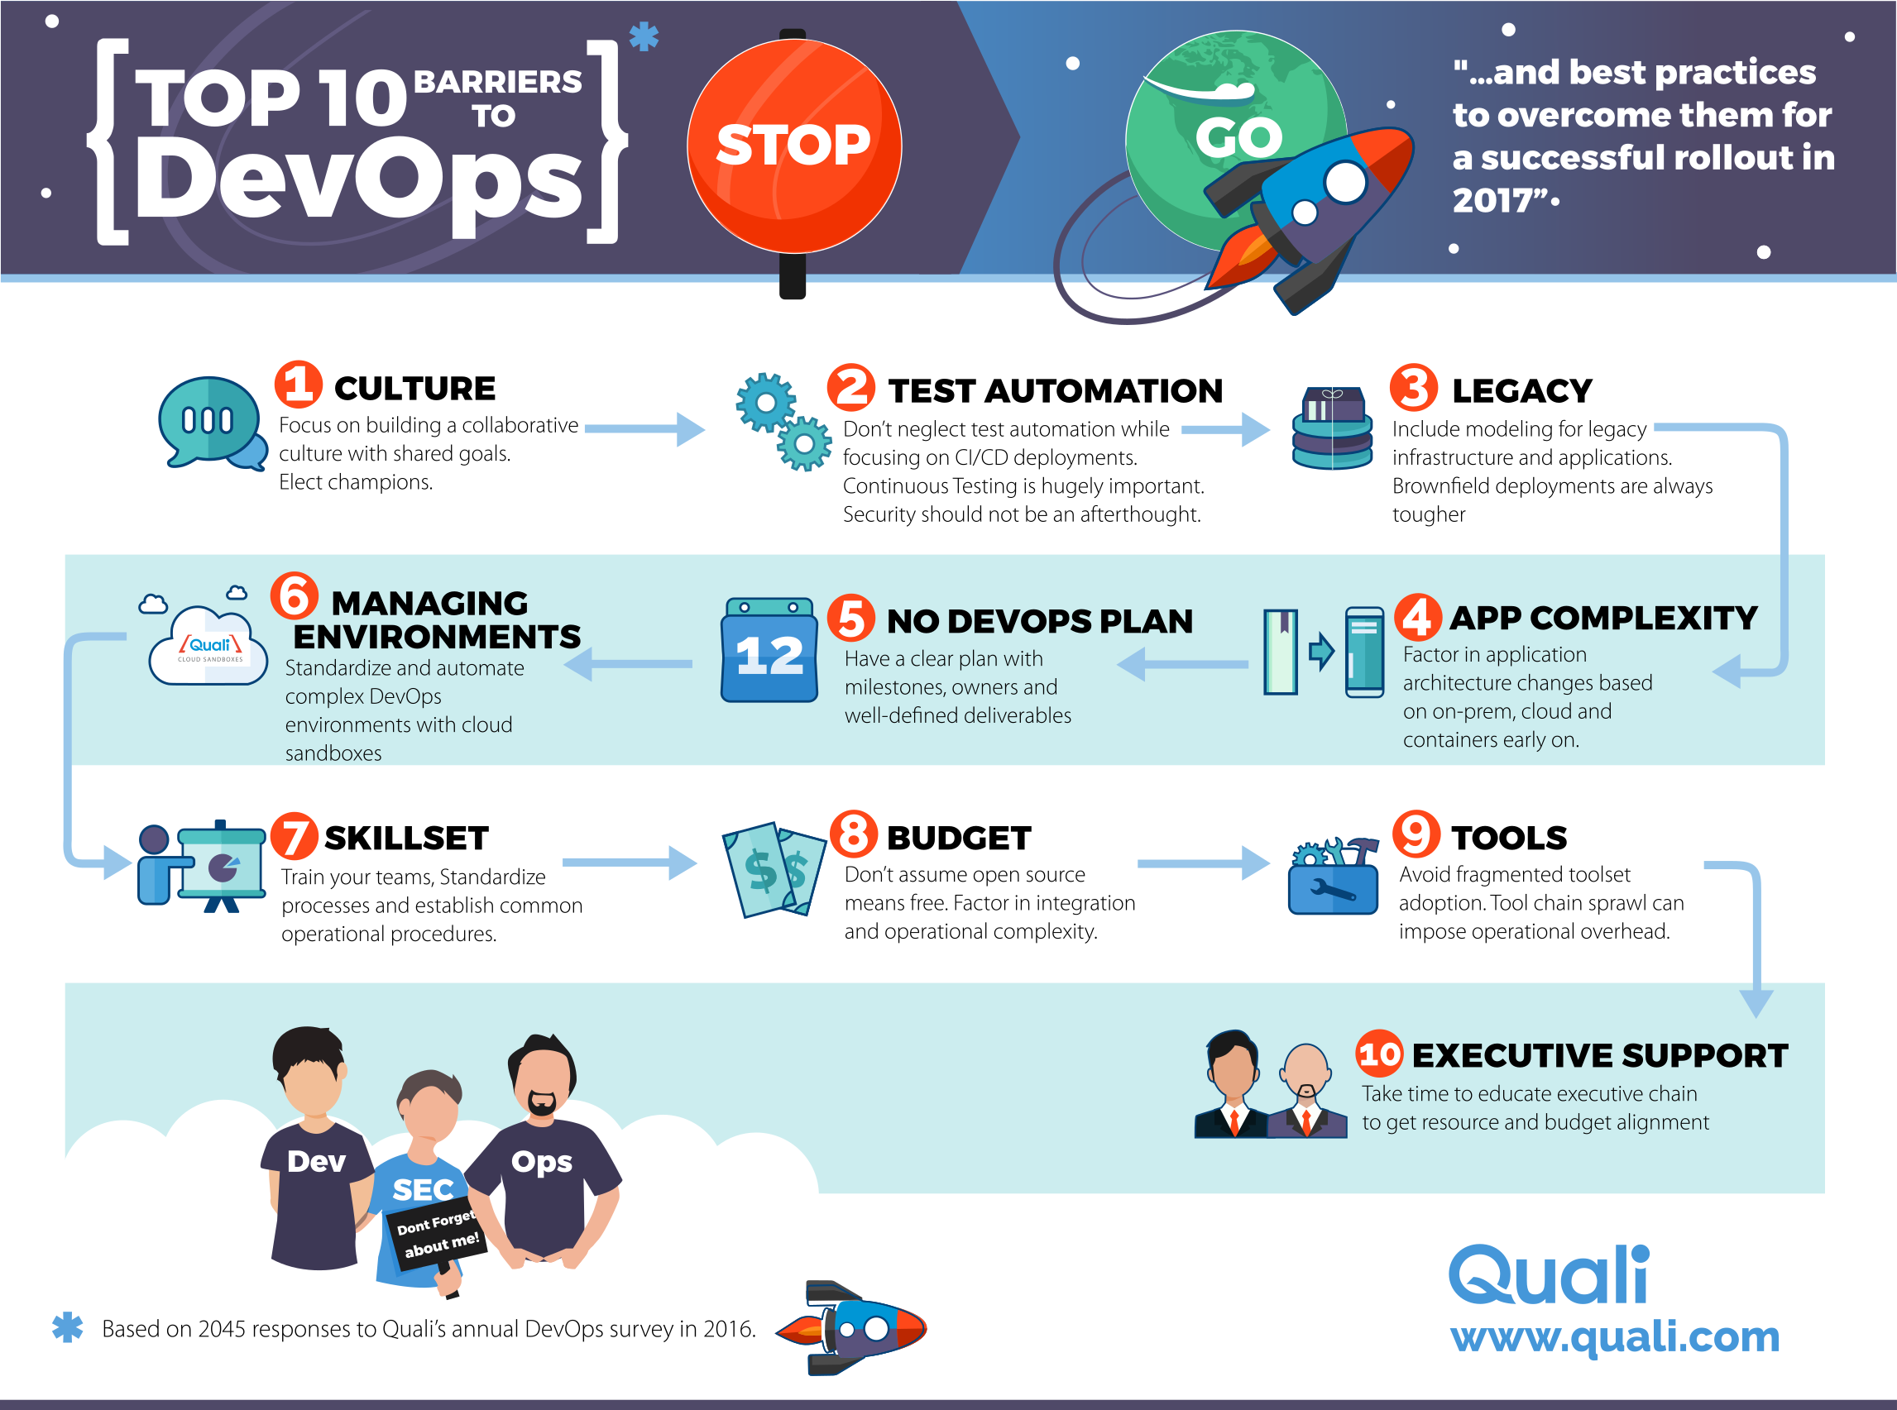

Slide 48
